Slide 1


Slide 2



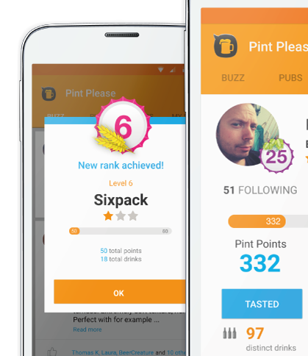
PINTPLEASE
USERS
SOLUTION
HOME
PROBLEM
mobile app for good quality beers
keep track of your favourite beers, get recommendations
share pubs and beers with your friends in your area

Slide 3


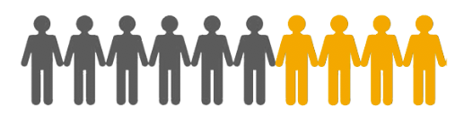
PINTPLEASE
USERS
SOLUTION
HOME
PROBLEM
♂ 25-45

Slide 4
PINTPLEASE
USERS
SOLUTION
HOME
PROBLEM
pains:
limited resources
not many people know the app (mostly Finnish users)
most people don’t recommend it further, although they like it
needs:
get more (active) users
more fun and interactive → gamified feature
motivate users to share the app with friends

Slide 5
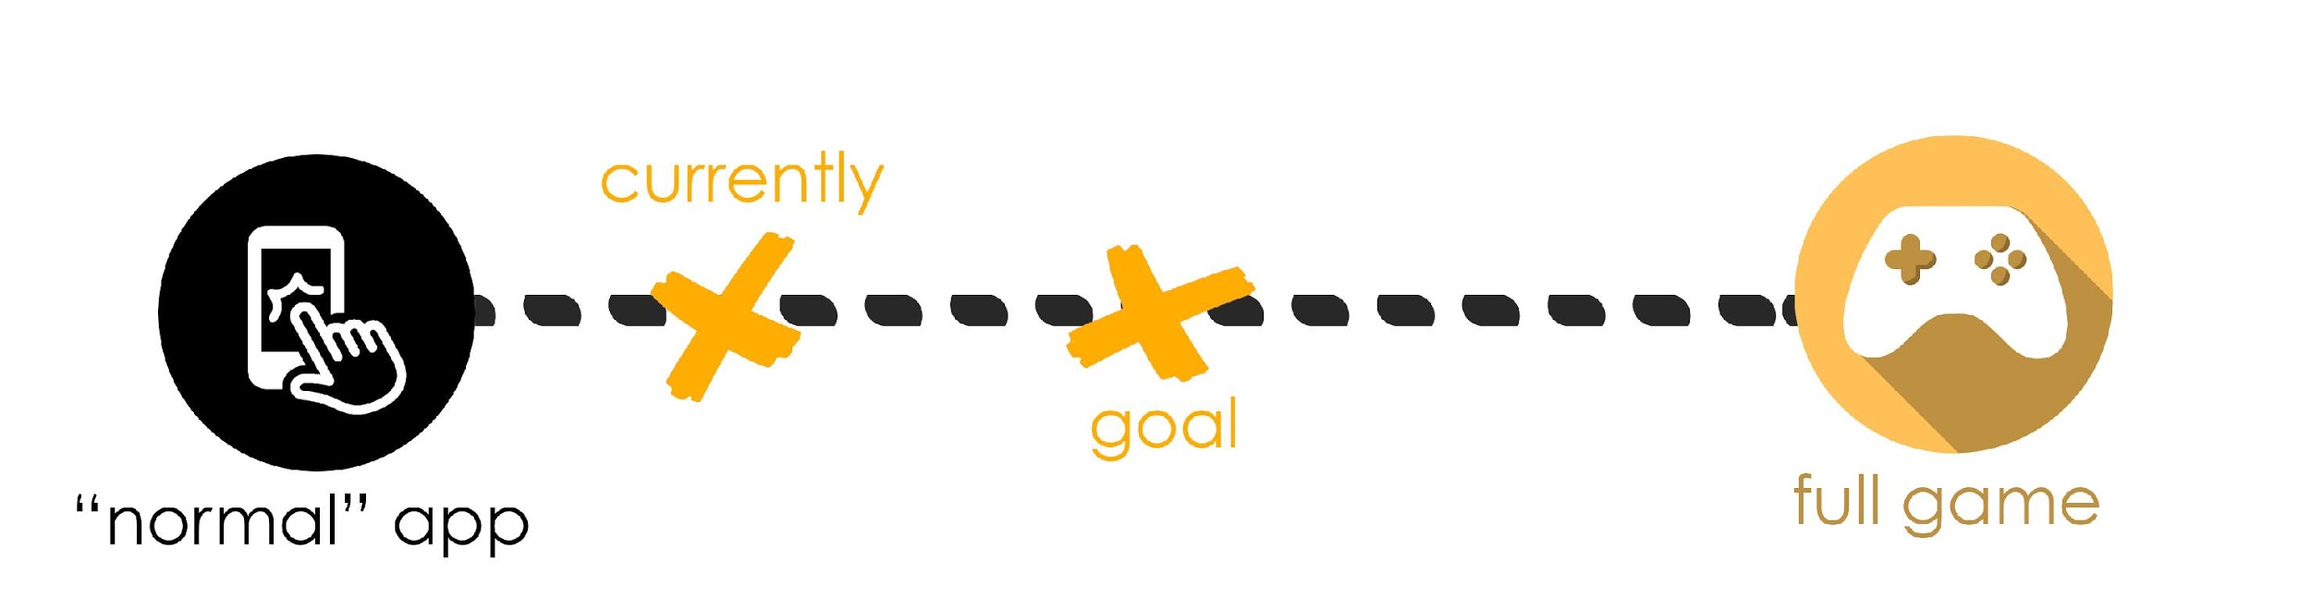
PINTPLEASE
USERS
SOLUTION
HOME
PROBLEM

Slide 6
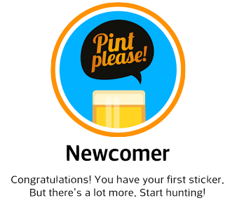
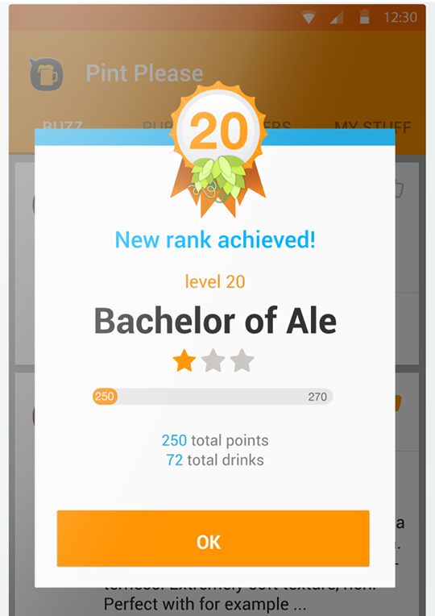
PINTPLEASE
USERS
SOLUTION
HOME
PROBLEM
current “game”-features: stickers and levels

Slide 7
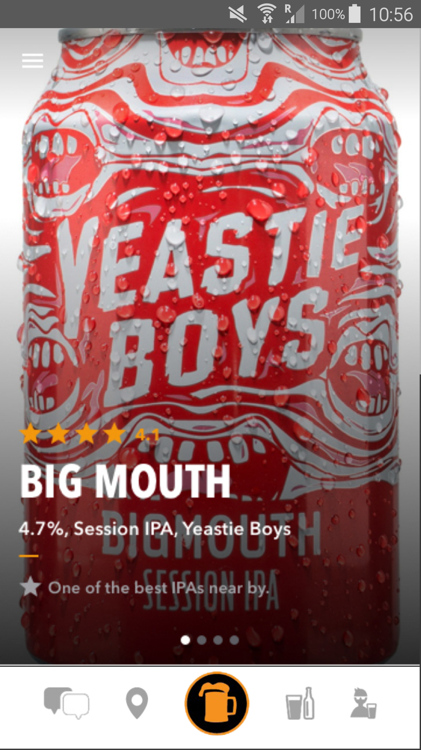
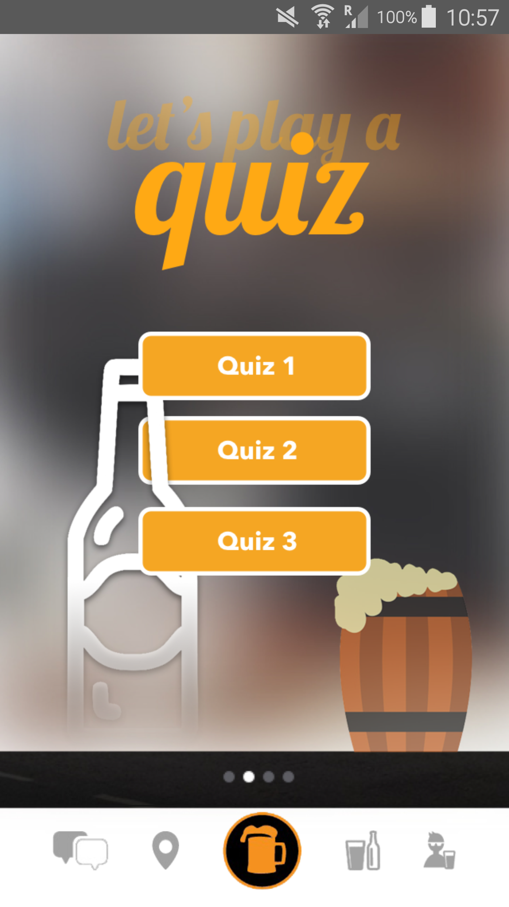
PINTPLEASE
USERS
SOLUTION
HOME
PROBLEM
daily quiz
questions based on your personal profile
collecting points for the levels by playing
sticker-rewards for playing regularly

Slide 8
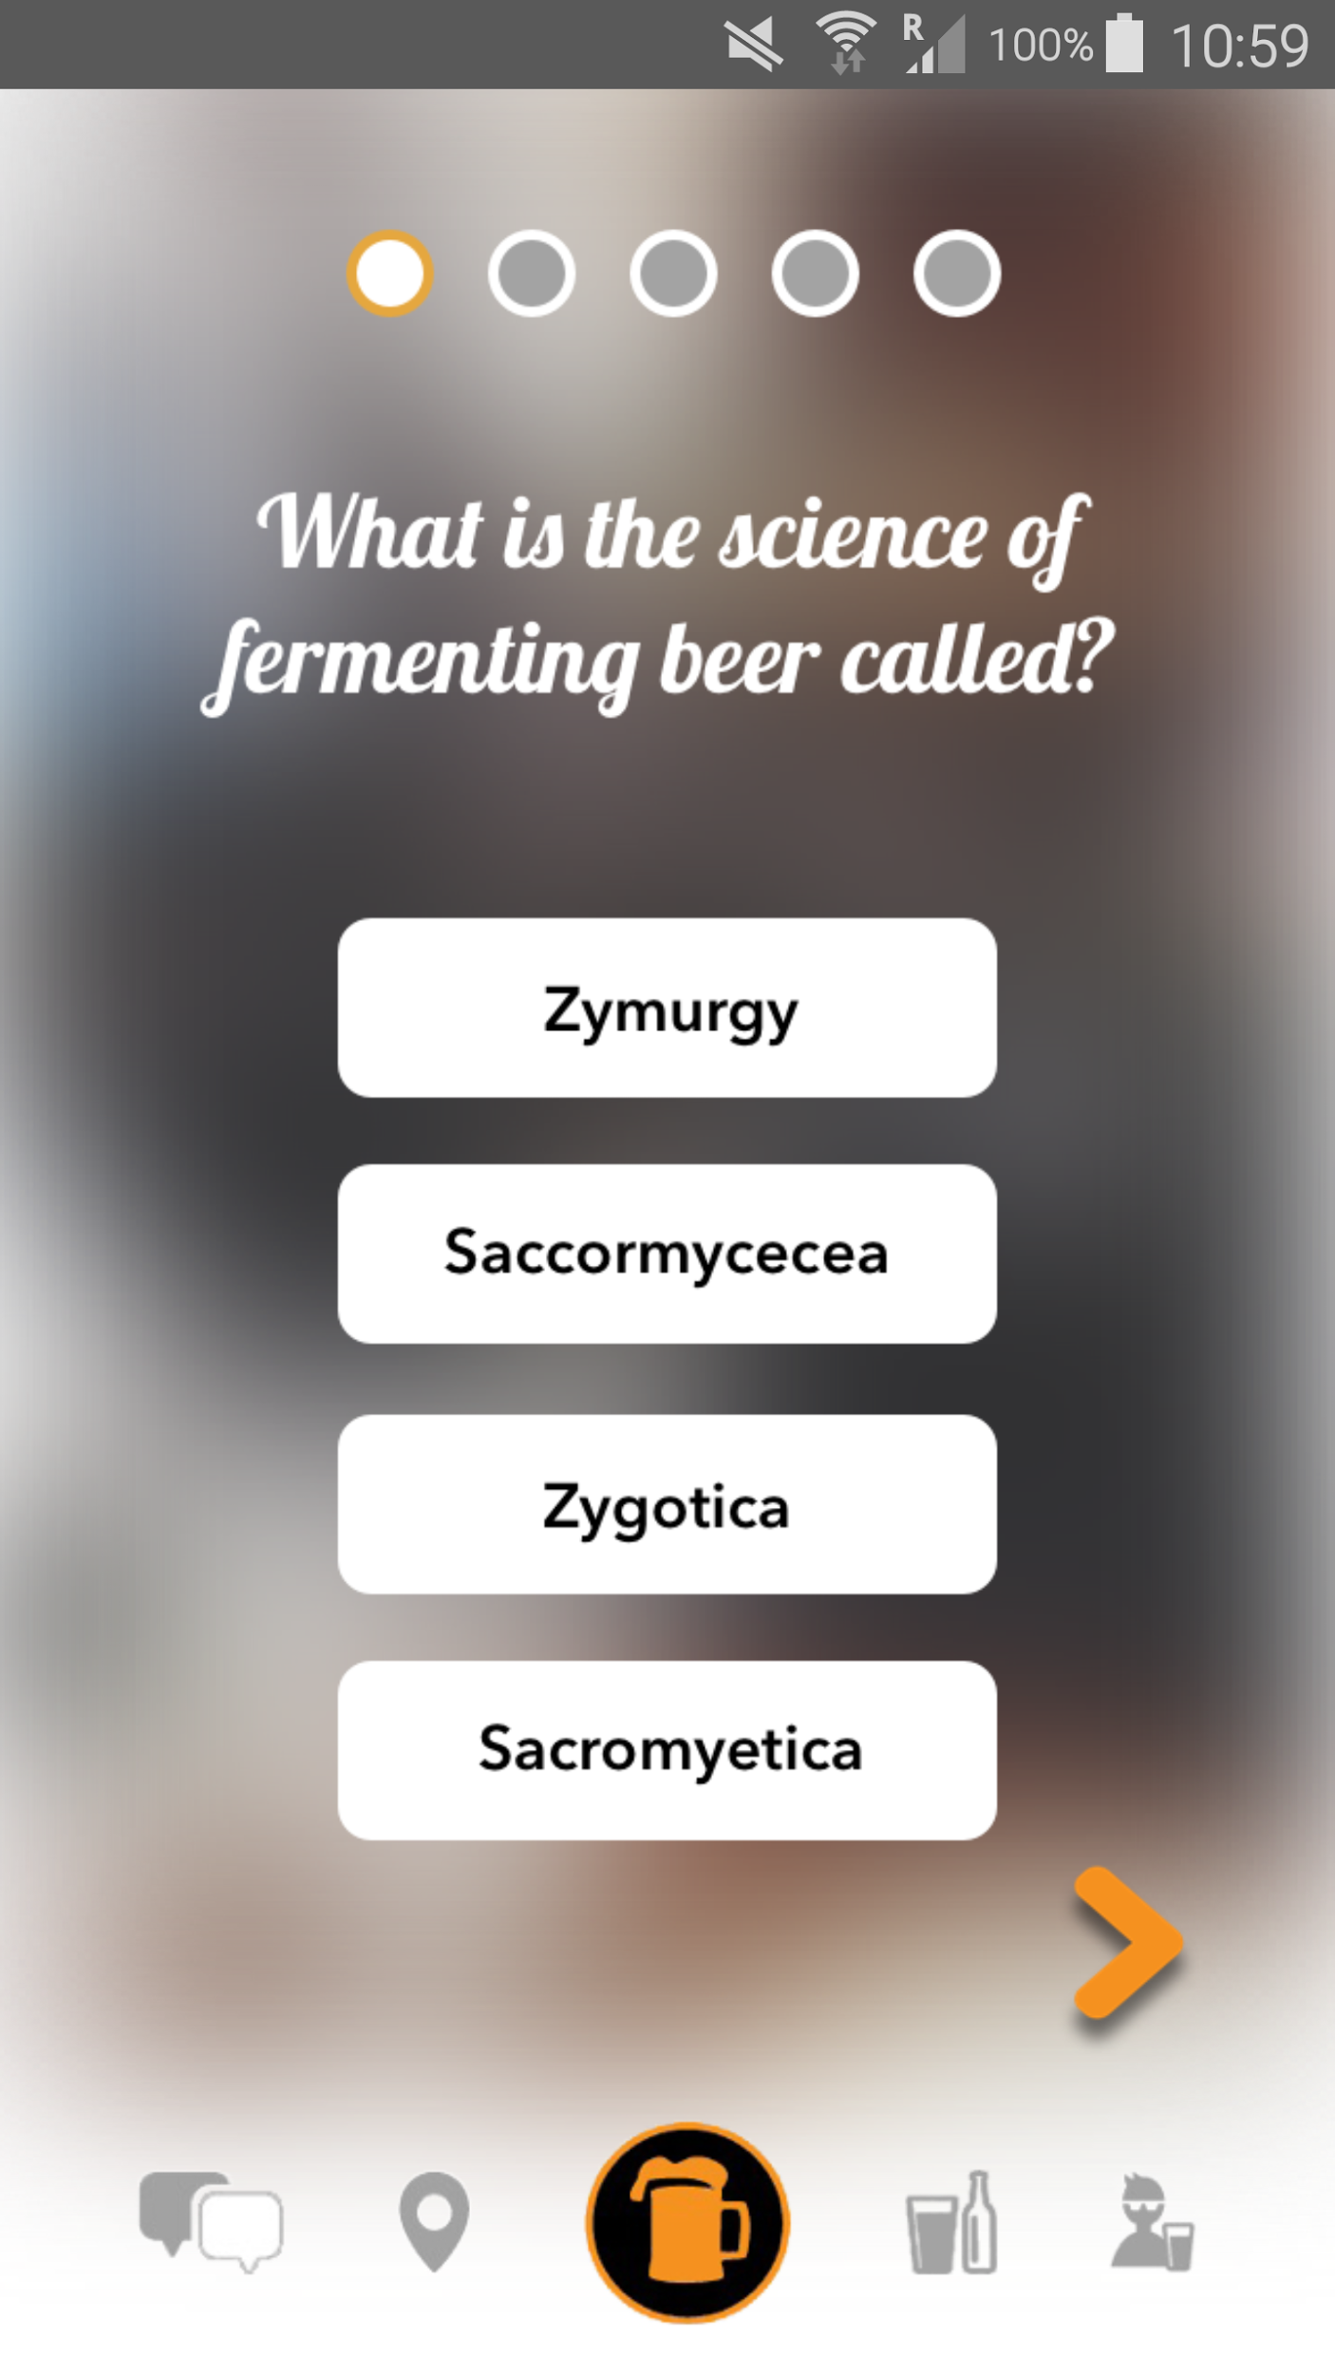
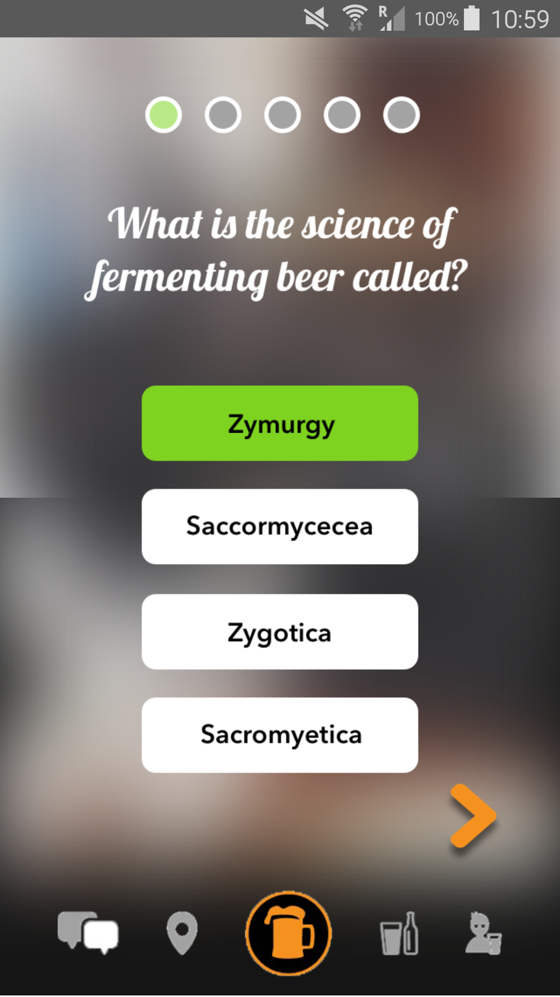
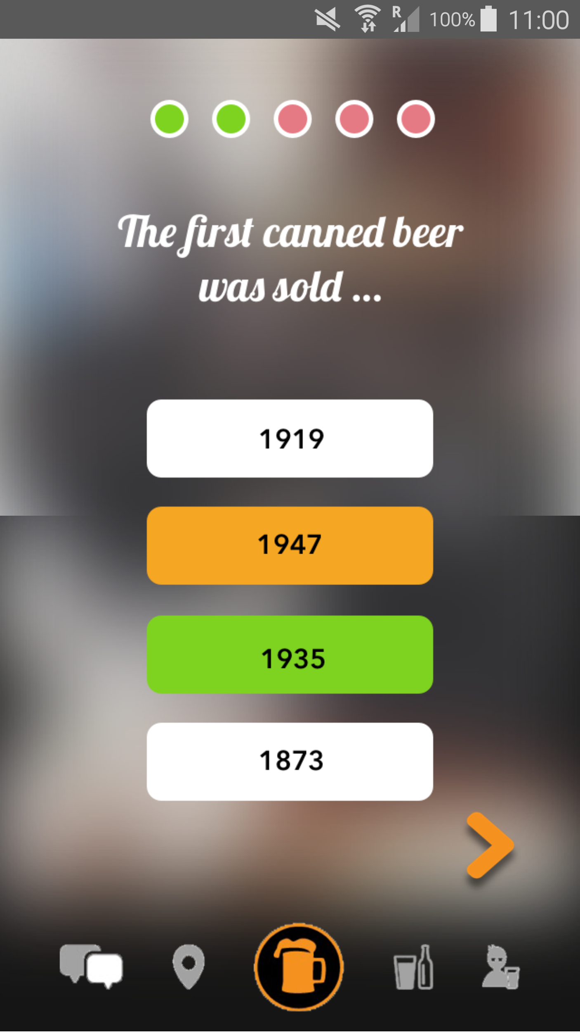
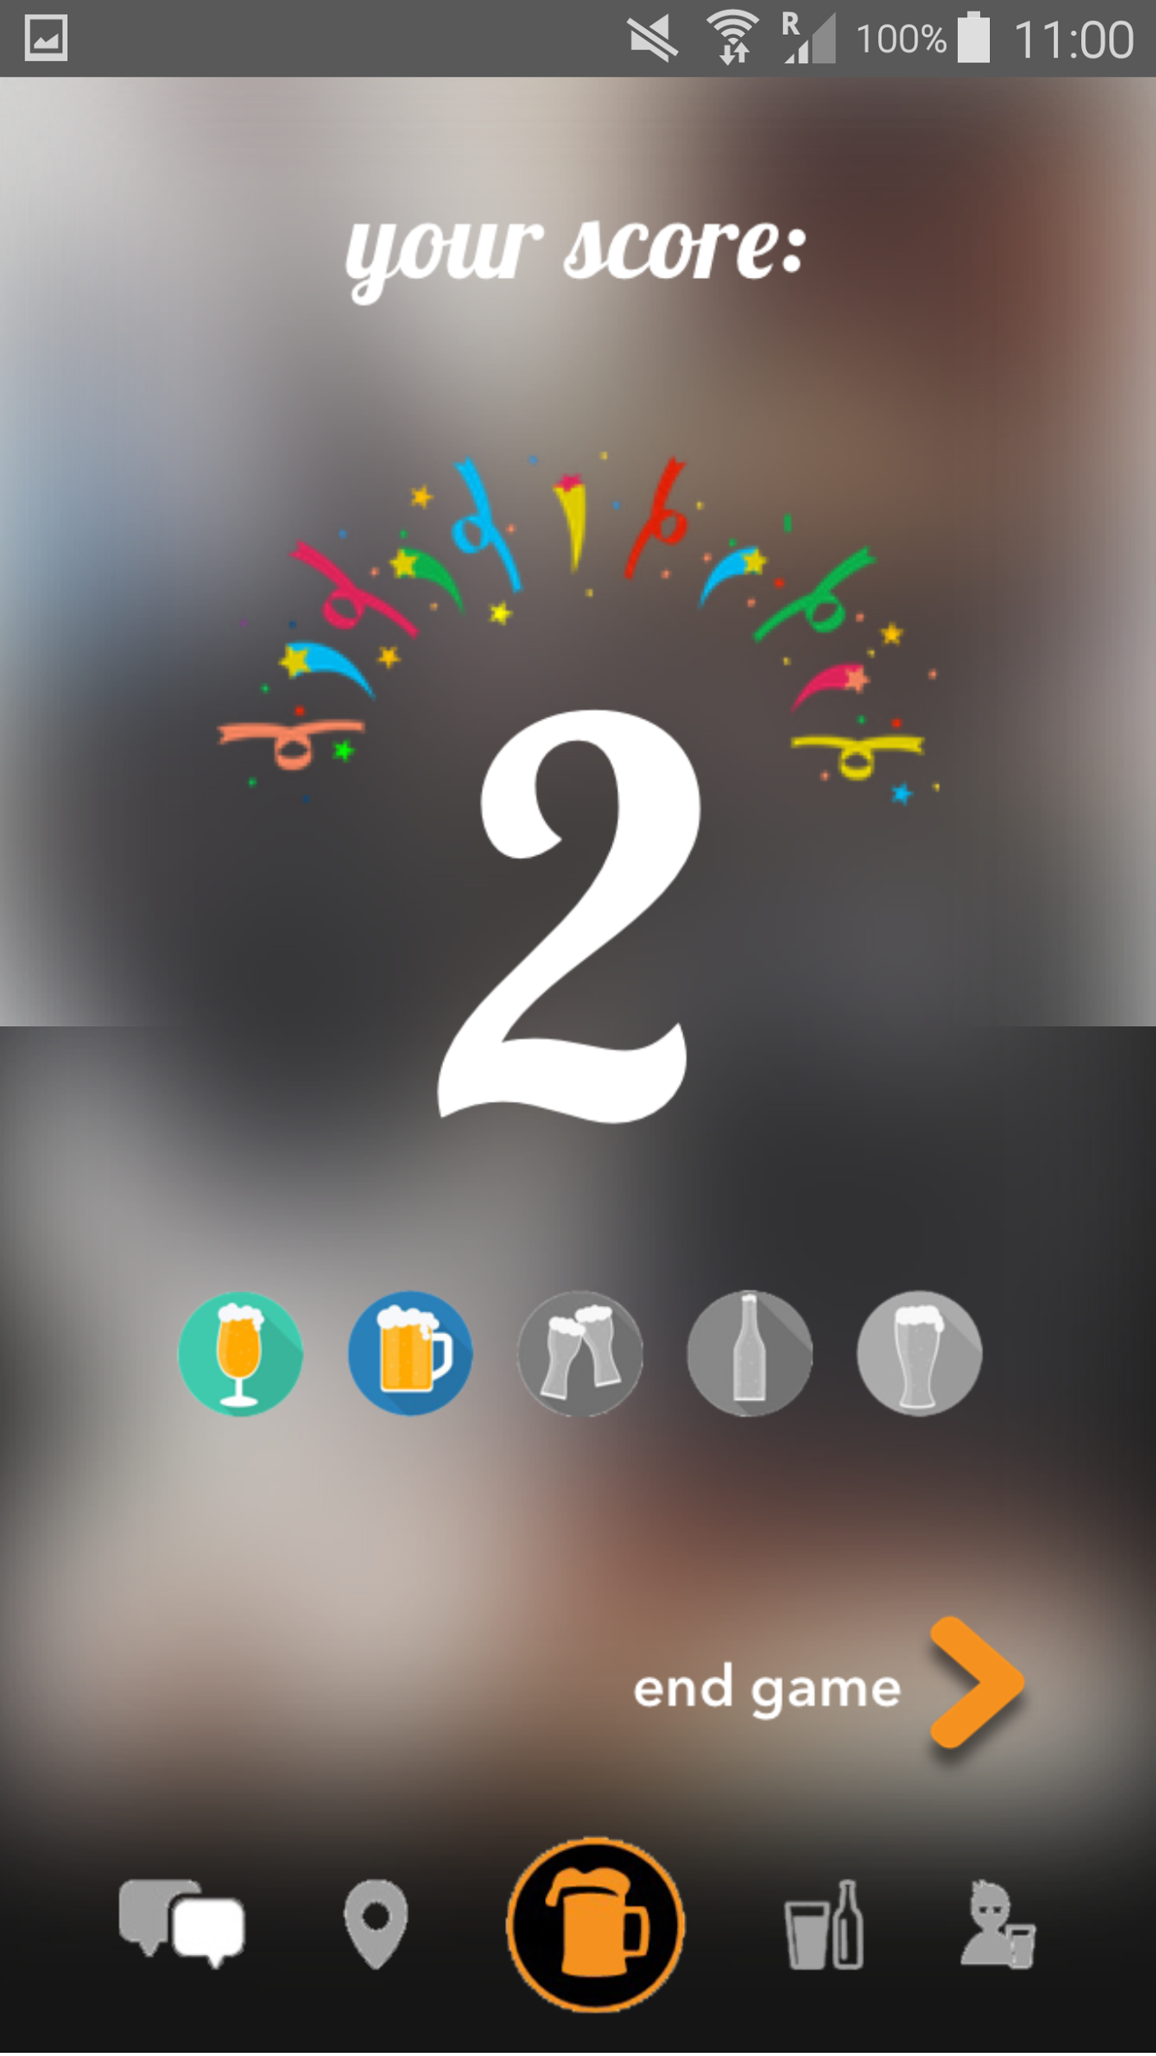
PINTPLEASE
USERS
SOLUTION
HOME
PROBLEM

Slide 9
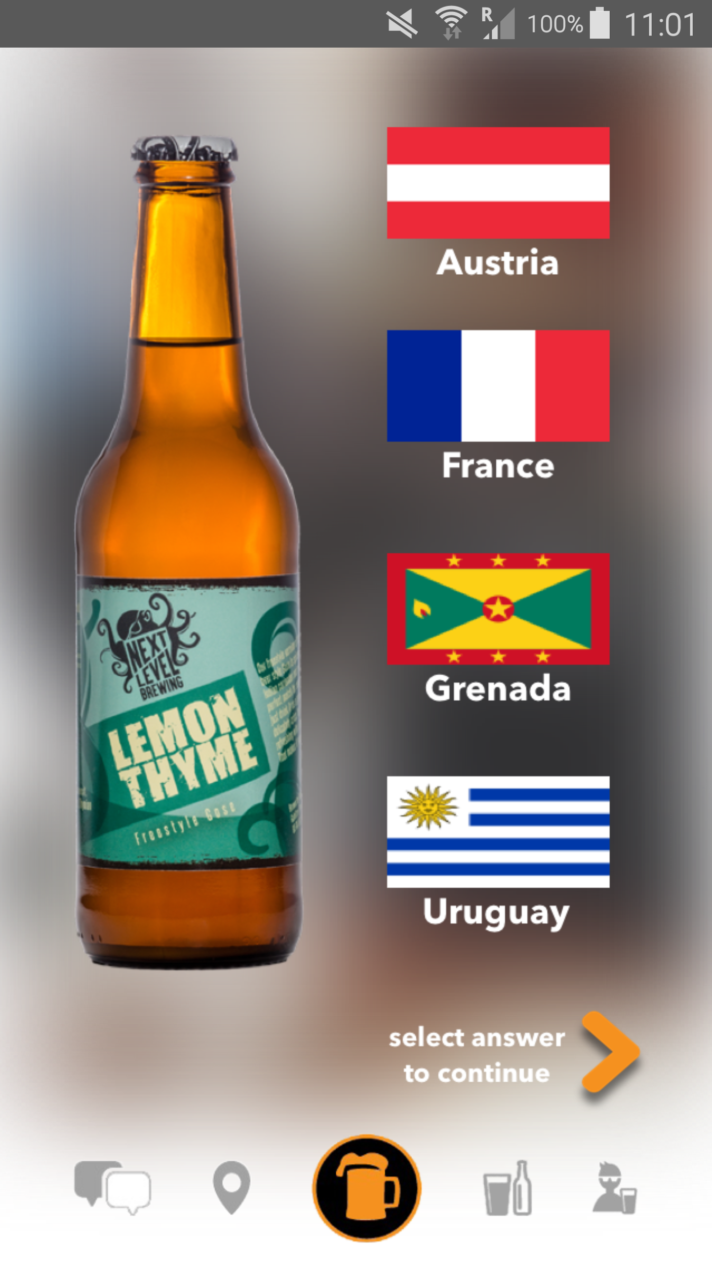
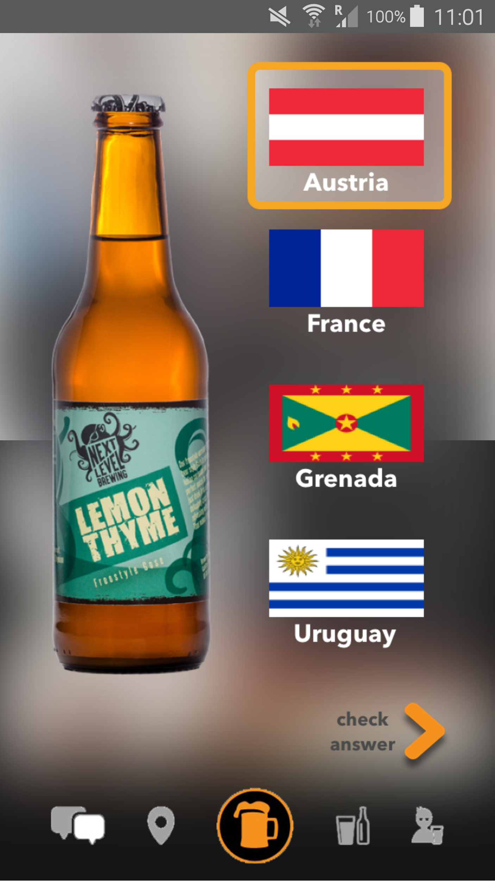
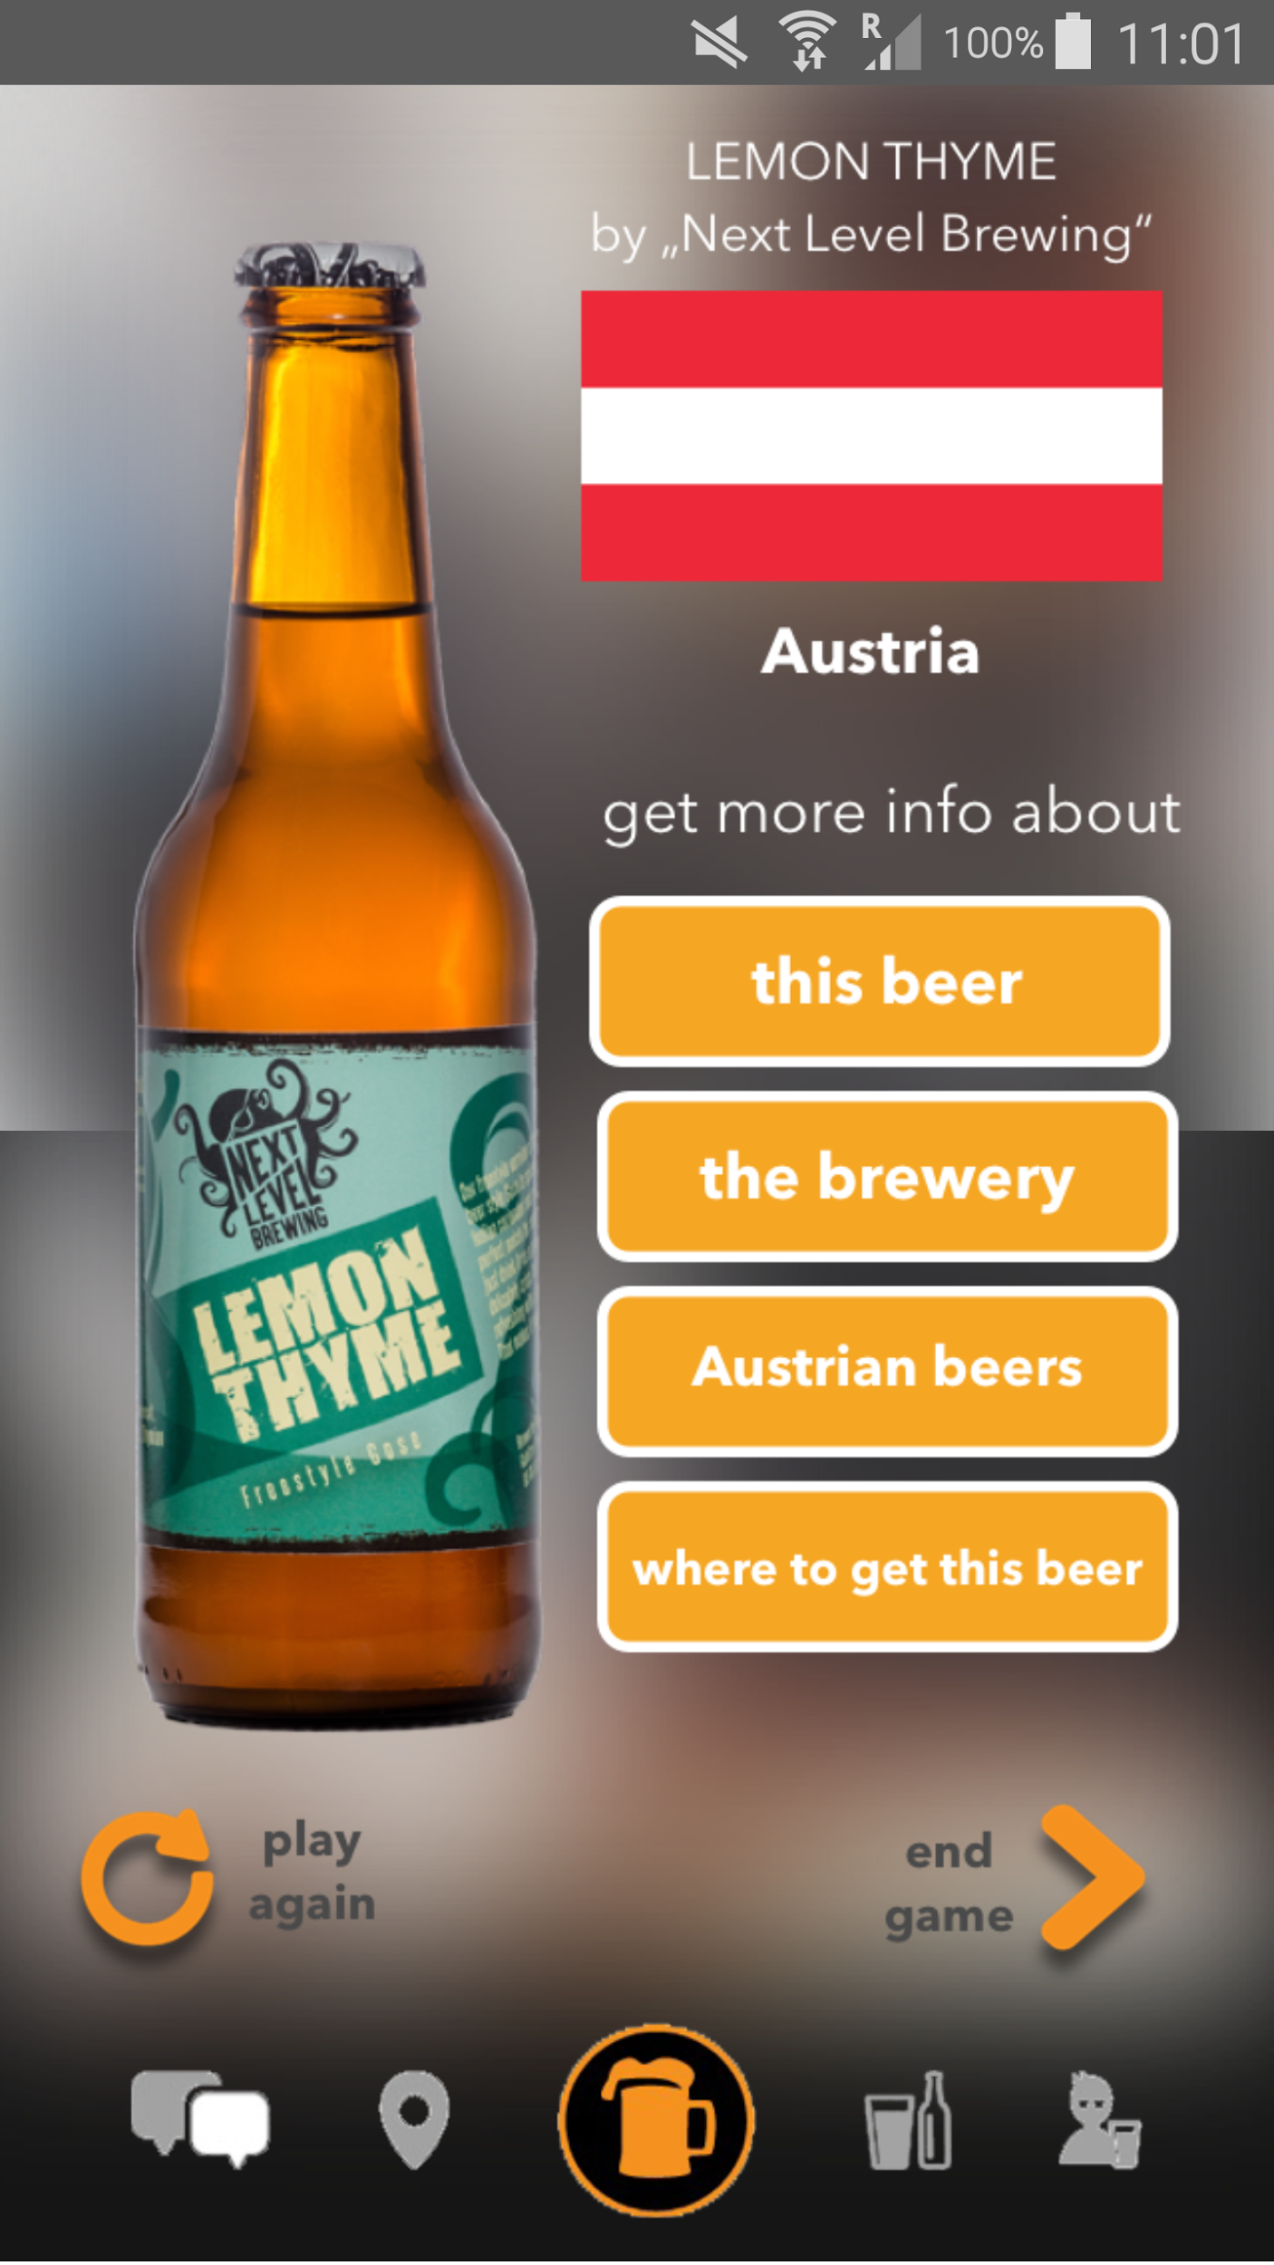
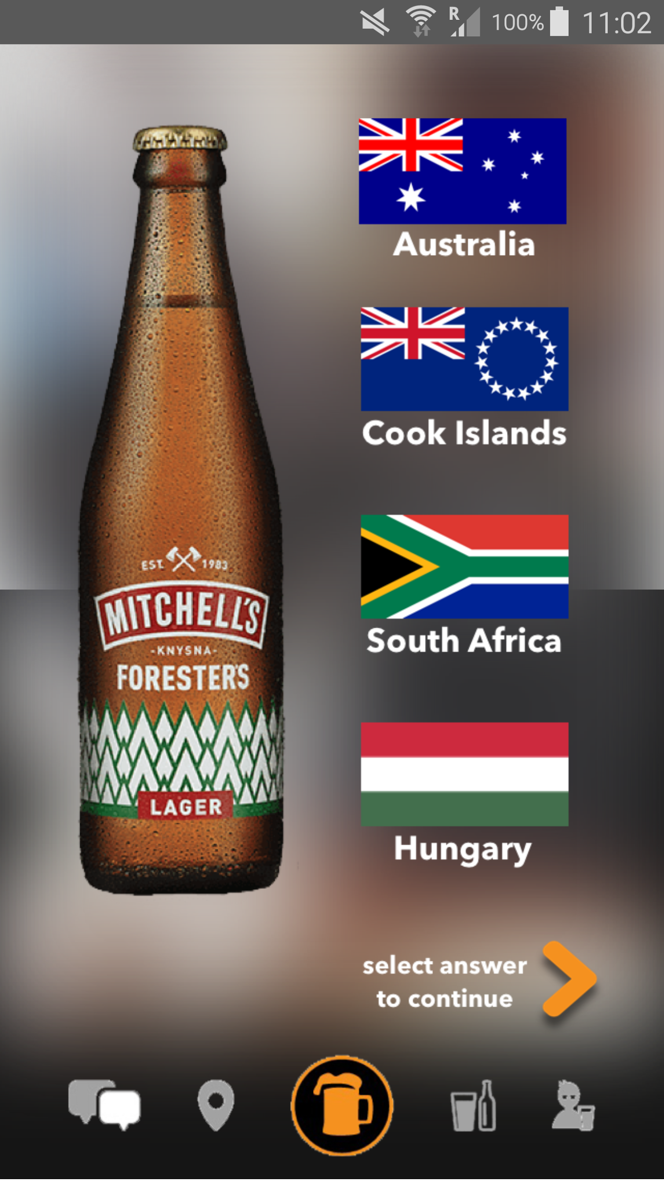
PINTPLEASE
USERS
SOLUTION
HOME
PROBLEM

Slide 10
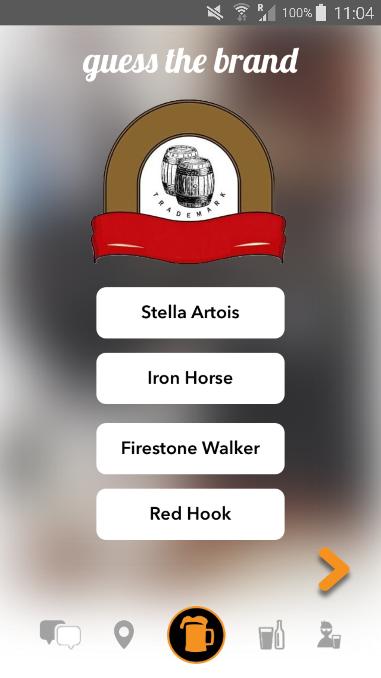
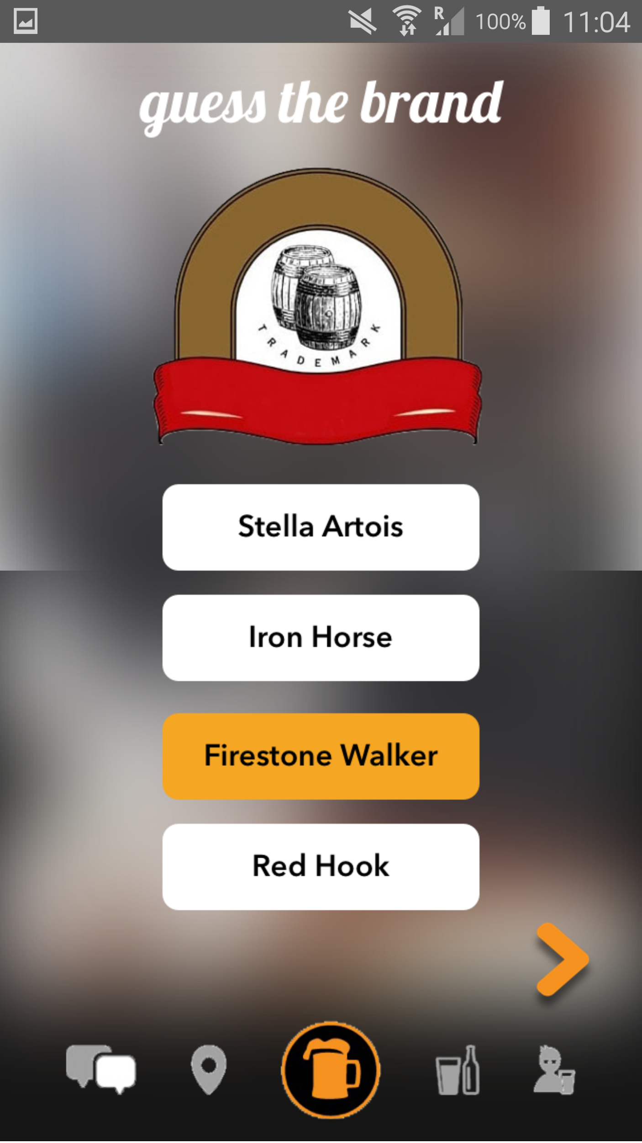
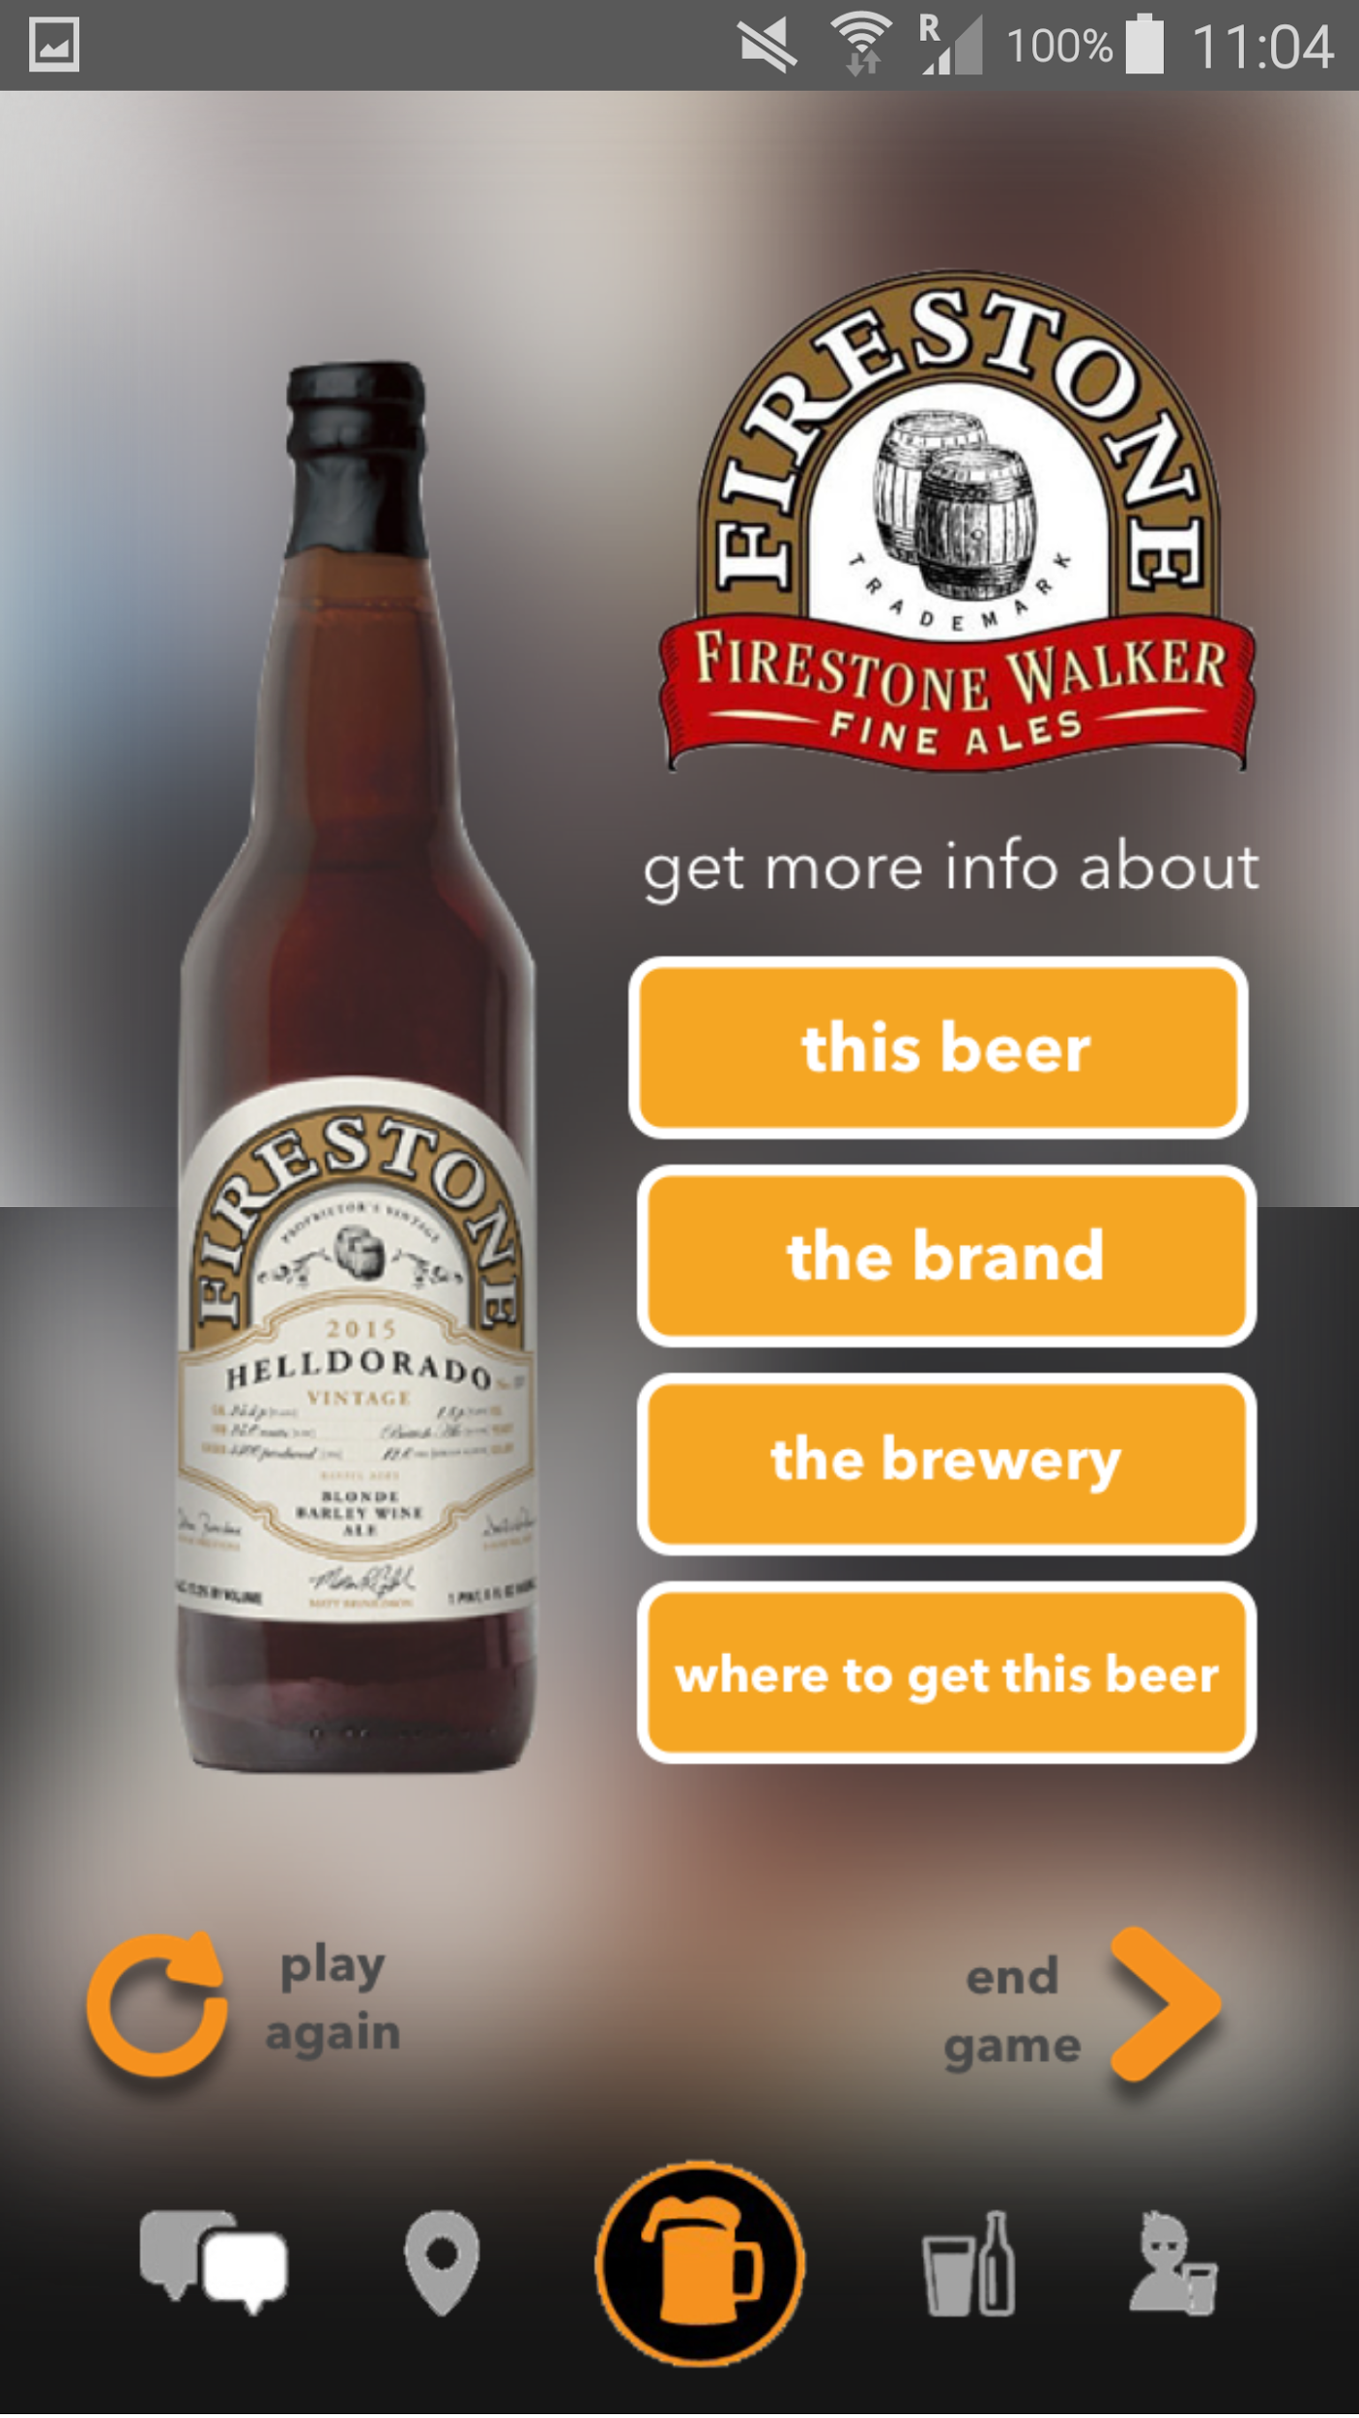
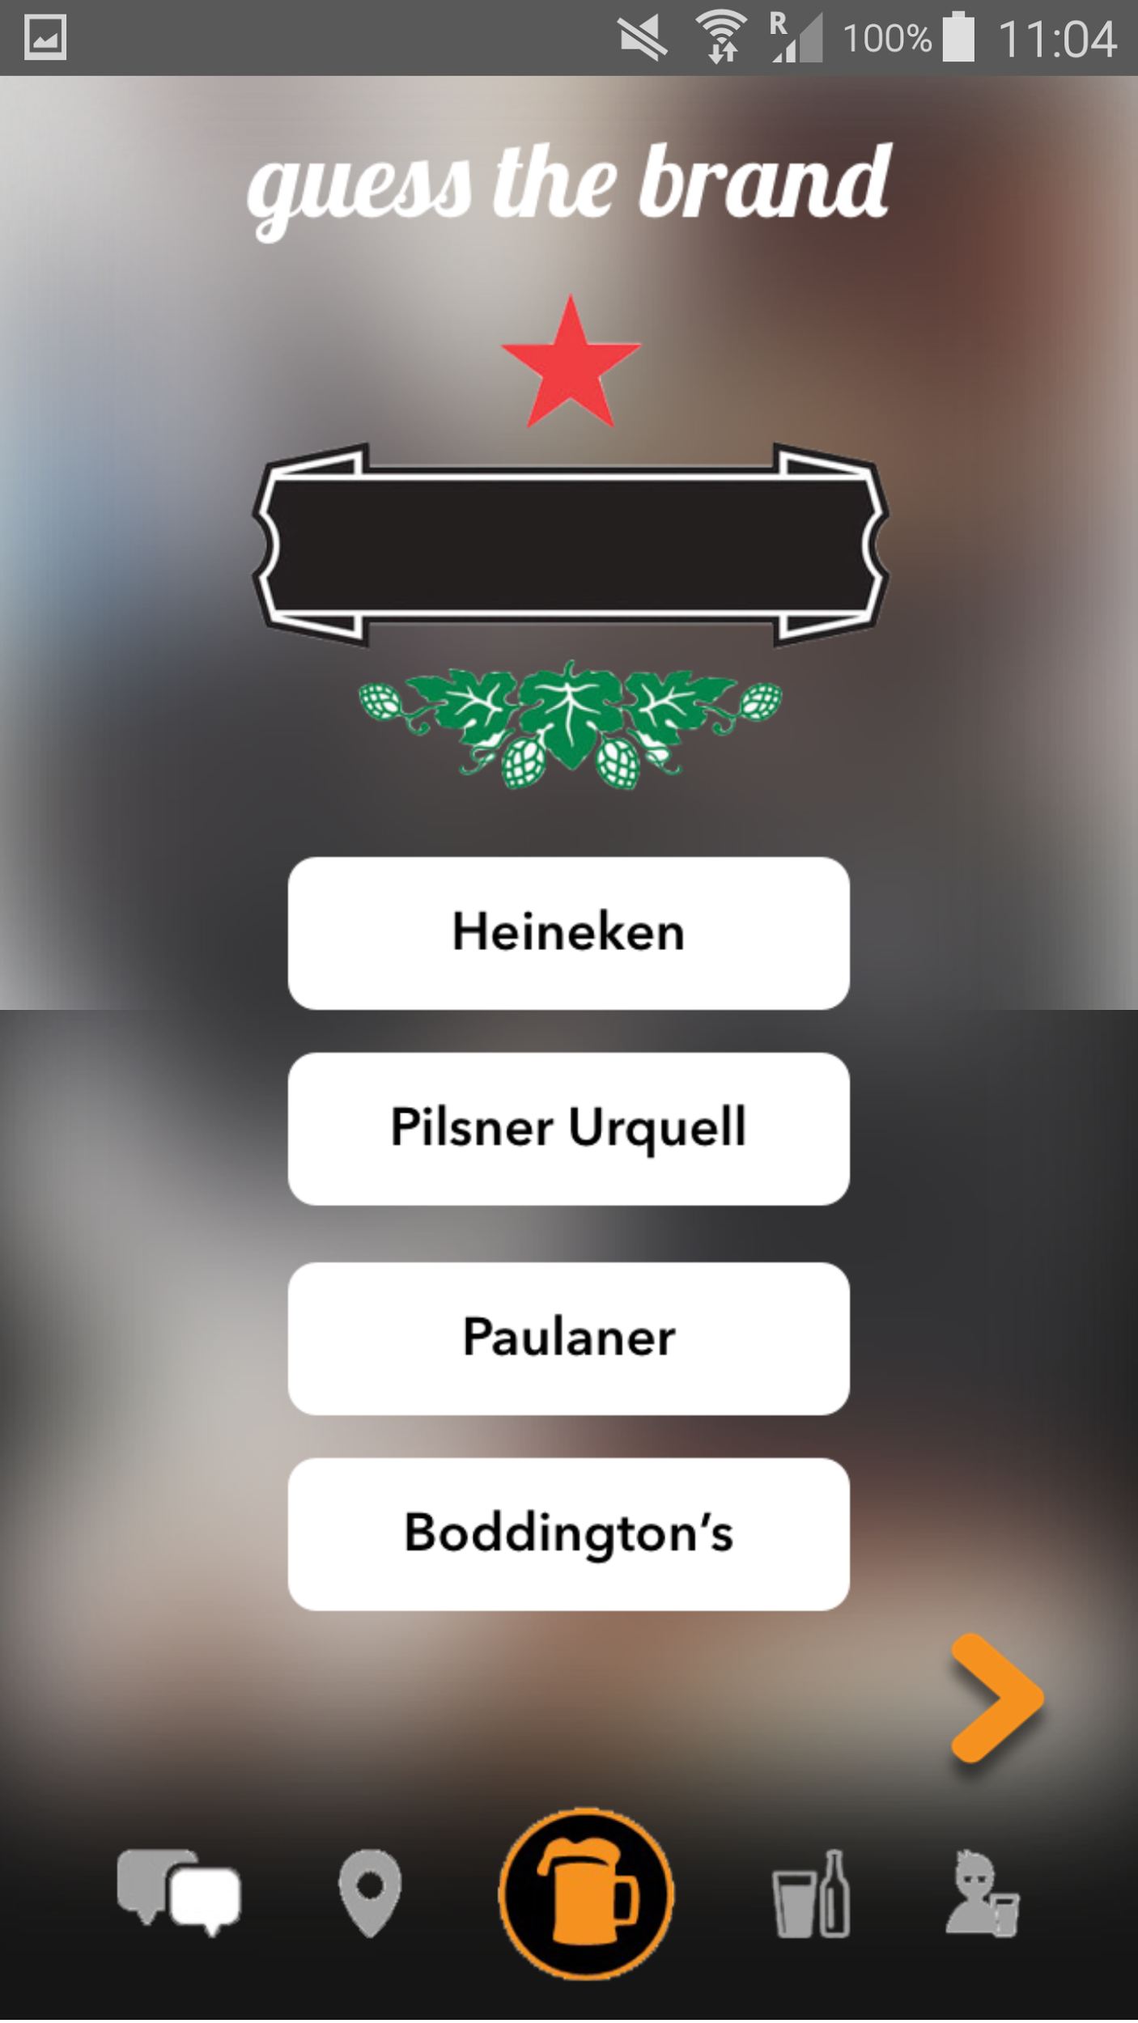
PINTPLEASE
USERS
SOLUTION
HOME
PROBLEM

Slide 11

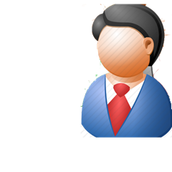
PINTPLEASE
USERS
SOLUTION
HOME
PROBLEM
5 test users
not a beer lover
quiz app lover
beer lovers,
experience with quiz apps

Slide 12
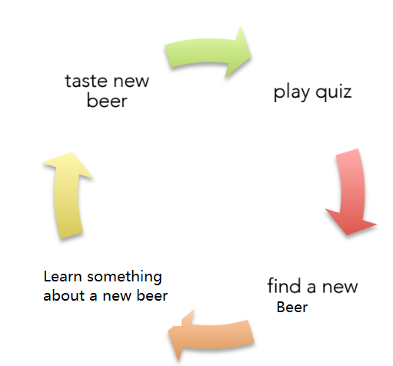
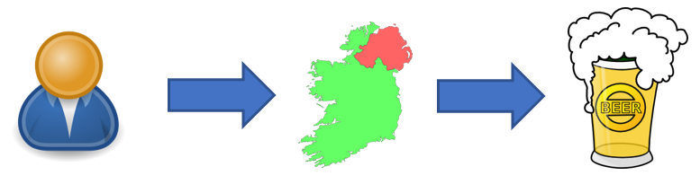
PINTPLEASE
USERS
SOLUTION
HOME
PROBLEM
test users’ behavior
A. using phone in the pub
B. country and local beer
C. how to know “better beer”
D. why they uninstalled quiz app
E. taste = learning
F. logo is easier to remember
G. Test users’ behavior prediction model

Slide 13


Thank you for
you attention!

